Slide 1
Presenter Name
Contact Information:

Slide 2
EDI Data Dashboard Presentation Slides Template
These slides provide an overview of the Early Development Instrument (EDI), summary of BC EDI Wave 8 data, and some template slides for you to add your own EDI Data.
Note: There are a lot of slides in this deck! We have included a number of “example” slides to assist with data interpretation. These example slides are hidden (will not be shown when in ‘slide show’ mode) and you can delete them as you craft your own presentation.
The Technical Guide found in the Resources Module of the EDI Data Dashboard has helpful tips and explanations.

Slide 3
Key Tips for Creating your Presentation
Information icon: Click on this symbol found throughout the Dashboard for explanations of data, charts and tables.
Download icon: Click on this symbol to download individual charts or an entire module as a .PNG. Save these images in a file on your computer. You will use these images to populate the slides in this presentation template.
Expanding images in a slide: As you insert charts from the EDI Data Dashboard you made need to re-size them. Click on the image – it will appear as shown here. Use the corners of the image to expand or shrink the size of an image evenly.
Printing: The Dashboard does not have a built-in printing or PDF export feature, but you may use your web browser’s print function to print a view of the Dashboard. To do this, right-click with a mouse and select “Print” on the pop-up that appears or try the shortcut CTRL+P (on a PC) or CMD+P (on a Mac) to bring up the browser’s Print function. If there is an issue fitting the full width of the Dashboard on a page, try reducing the scale of the print view. Some browsers will allow you to save a PDF by ”printing” to PDF.

Slide 4
Notes:
The full EDI Wave 8 Provincial Summary online report is available here: https://earlylearning.ubc.ca/reports/edi-reports/

Slide 5
Our work takes place on the traditional, ancestral, unceded territory of the xʷməθkʷəy̓əm (Musqueam) people
Reconciliation Pole,
Hereditary Chief 7idansuu (James Hart), Haida
© UBC Communications & Marketing
Photo: UBC / Paul Joseph
Notes:
Photo credit: UBC Communications & Marketing
Reconciliation Pole, Hereditary Chief 7idansuu (James Hart), Haida

Slide 6
HELP was founded as a research centre dedicated to exploring “the differences that make a difference” in children’s early development.
In 1999, Dr. Clyde Hertzman and Dr. Hillel Goelman
pioneered a program of research to explore
“the differences that make a difference”
in children’s early development.
Notes:
An 1999, Dr. Clyde Hertzman and Dr. Hillel Goelman pioneered a program of research to explore “the differences that make a difference” in children’s early development. Dr. Hertzman understood that without high-quality data and research, problems would remain unseen and no action would be taken to solve them. Dr. Hertzman envisioned a unique child development monitoring system that follows populations of children across their development, offering high-quality data and research to inform actions to ensure “equity from the start” for all children.

Slide 7
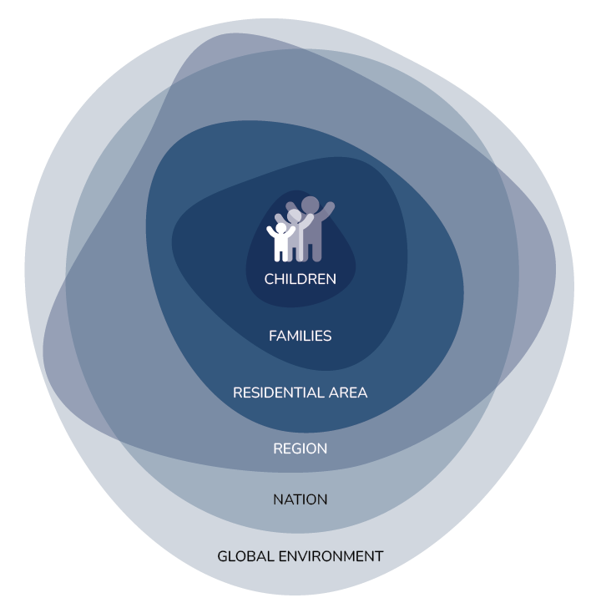
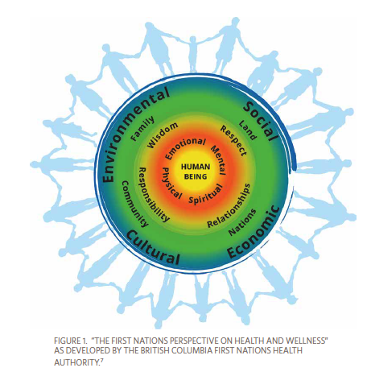
Contexts Influencing Child Development
Notes:
At HELP our work is grounded in the understanding children live, grow and learn within many interconnected contexts which impact their experiences and development – at HELP we talk about this influence being from ‘society to cell’.
These models help provide a perspective on the various influences on children’s lives – one is from HELP and the other is from the FN Health Authority.

Slide 8
The Early Years Matter…
Early childhood development is a social determinant of health
Notes:
Decades of research have demonstrated that early child development is itself a social determinant of health. Meaning, that that the quality of the experiences and the environments in which children grow and develop in the early years have long-reaching influence on health and well-being over time and across generations.

Slide 9
Child Development Monitoring System
Toddler Development Instrument
12 - 24 months
Parent & caregiver questionnaire
Childhood Experiences Questionnaire
Start of kindergarten
Parent & caregiver questionnaire
Early Development Instrument
Mid-kindergarten
Teacher
questionnaire
Middle Years Development Instrument
Grades 4 - 8
Student
questionnaire
Youth Development Instrument
Grade 11
Student
questionnaire
EARLY EXPERIENCES & CONTEXTS
EARLY EXPERIENCES & CONTEXTS
SKILLS & COMPETENCES
WELL-BEING
& ASSETS
WELL-BEING
& ASSETS
Notes:
At HELP, we collect data about children’s experiences and development through the Child Development Monitoring System which consists of five questionnaires (the TDI, CHEQ, EDI, MDI and YDI) that provide connections across the early life course: from toddlerhood and into kindergarten, in Grades 4 through 8, and finally during secondary school in Grade 11. It gathers information on critical periods in children’s development, exploring individual, family, and community factors from a diversity of perspectives: parents, teachers and children themselves. These questionnaires support the collection of population-level data about children’s outcomes, experiences and environments that are needed to address and answer the question: “What are the differences that make a difference?”
The YDI is an affiliated population-level tool developed and implemented by Dr. Hasina Samji who is an affiliate HELP faculty and is with SFU and BCCDC.

Slide 10
Child Development Monitoring System
Toddler Development Instrument
12 - 24 months
Parent & caregiver questionnaire
Childhood Experiences Questionnaire
Start of Kindergarten
Parent & caregiver questionnaire
Early Development Instrument
Mid-kindergarten
Teacher
questionnaire
Middle Years Development Instrument
Grades 4 - 8
Student
questionnaire
Youth Development Instrument
Grade 11
Student
questionnaire
EARLY EXPERIENCES & CONTEXTS
EARLY EXPERIENCES & CONTEXTS
SKILLS & COMPETENCES
WELL-BEING
& ASSETS
WELL-BEING
& ASSETS

Slide 11
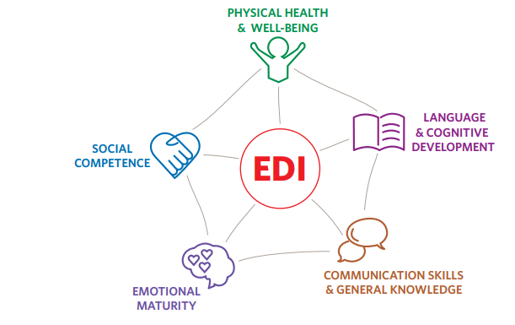
Early Development Instrument (EDI)
Notes:
The foundation of the Monitoring System is the Early Development Instrument (EDI), which has now been collected for 20 years here in BC. The collection of the EDI is funded by the BC ministries of Health, Education and Child Care, and Children and Family Development.
The EDI is a questionnaire completed by kindergarten teachers for the students in their classroom in February of the school year. The intention of the EDI is to reflect the development of the “whole child”. These are the 5 scales of the EDI: Physical Health & Well-being, Language & Cognitive Development, Communication Skills & General Knowledge, Emotional Maturity, and Social Competence.
Completed EDI questionnaires are grouped together to give a snapshot of how children are doing at the school, school district, neighbourhood, and provincial level. It measures the distribution of developmental outcomes in populations of kindergarten children.
A copy of the questionnaire is available on our website along more details about the EDI and the scales.

Slide 12
Population vs. Individual Monitoring
Individual assessments
Population-level monitoring
The EDI is not a teacher or school evaluation.
Notes:
The EDI is a population-level monitoring tool; data are used to consider the health and well-being of populations of children now and over time.
The EDI data is NOT an individual assessment or diagnostic tool, nor is it used to evaluate teachers or schools.

Slide 13
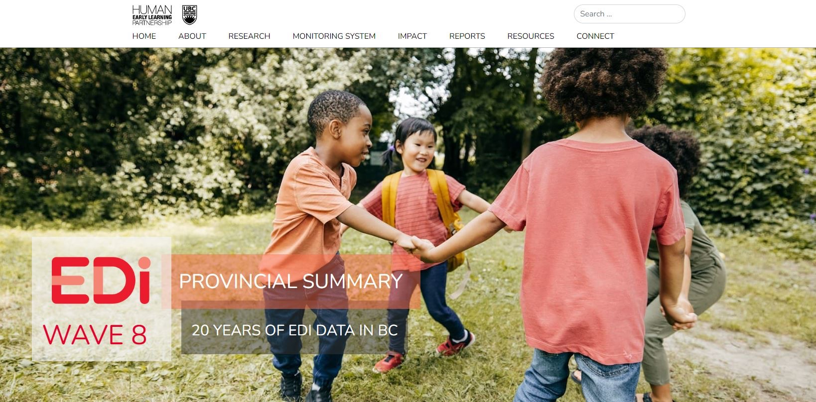
Notes:
The EDI Wave 8 Provincial Summary online report is available on our new website.

Slide 14
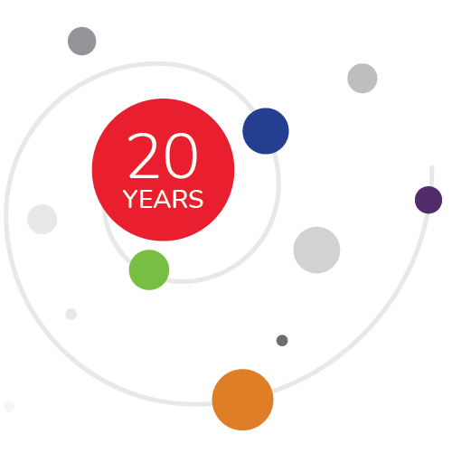
Data Collection History
Notes:
The following graphic shows the data collection history for the EDI in BC. The EDI questionnaire is province-wide, 57 school districts participate along with some participating independent and First Nation schools. To date, we have collected data on over 330,000 Kindergarten children in BC since 2001.
As you can see, we group data collection periods into “waves” which encompass 2-3 years. We invite school districts to participate in Waves depending on their size. Smaller districts may participate more frequently to ensure that the number of children covered in each neighbourhood is large enough to be reliable and to track meaningful change over time. Whereas, larger districts participate only once in the 3 year wave.
This presentation is a review of Wave 8 EDI data.

Slide 15
EDI Overall Vulnerability in BC
Notes:
Let’s get into the Wave 8 data!
Starting with Overall Vulnerability in BC…

Slide 16
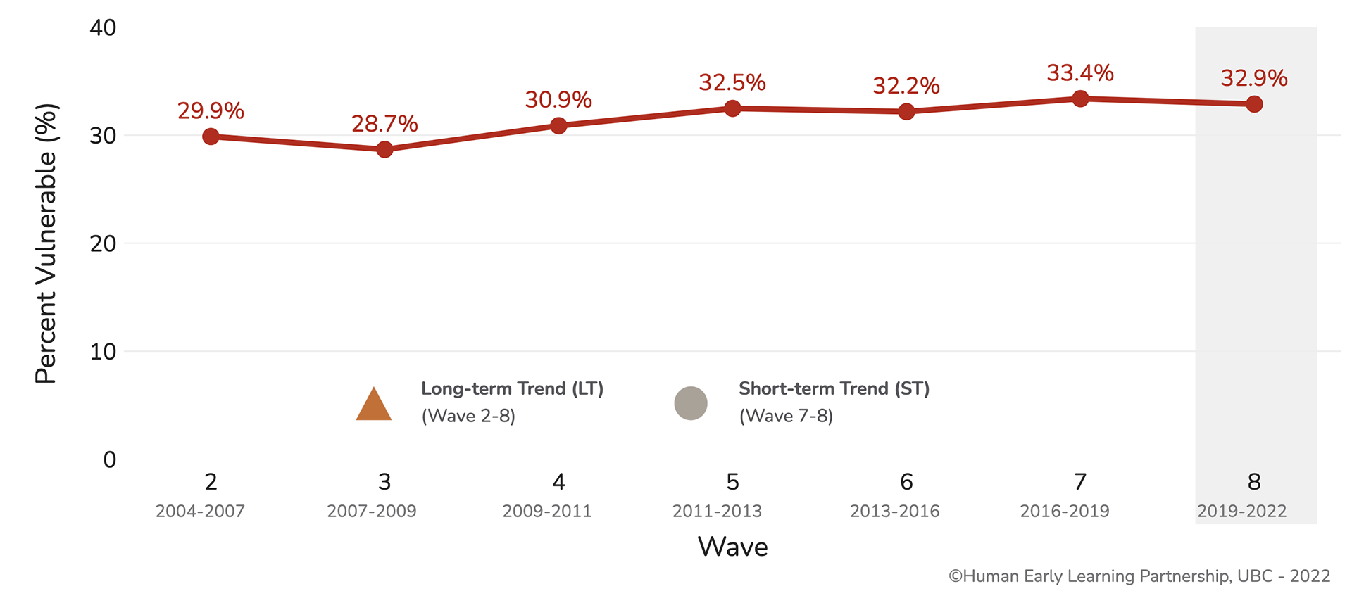
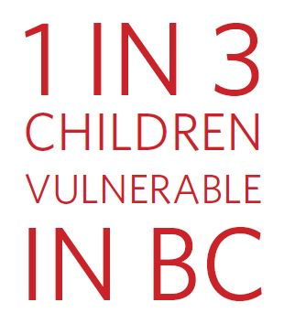
BC Overall Vulnerability, Over Time, Wave 2 – Wave 8
Long-term Trend:
Meaningful Increase
Short-term Trend: Stable
Notes:
This graph shows the trend line from W2 (data collected between 2004-2007) to W8 on the summary measure “Vulnerable on One or More Scales” that reports the percentage of children who are vulnerable on at least one EDI scale, but may be experiencing vulnerabilities in two, three, four or all five scales.
You can see that in Wave 8, 32.9% of kindergarten children were vulnerable on one or more scales of the EDI. Research has shown that children who are vulnerable on the EDI, without care and support, are the more likely to experience difficulties in their school years and beyond.
Over the long-term, there has been a ‘meaningful increase’ in overall vulnerability rates, rising from 29.9% in Wave 2 to 32.9% in Wave 8. To determine meaningful change, HELP uses a method called critical difference to indicate if the change in rates between two points in time is both statistically significant and large enough to be “worth talking about”… and over the long-term, the increase as been meaningful.
Over the short term, the overall vulnerability rate went down slightly from 33.4% in Wave 7 to 32.9% in Wave 8 but the trend is considered stable… as in Wave 7, there are still 1 in 3 children starting school vulnerable in at least on developmental area important to their future success in school and beyond.

Slide 17
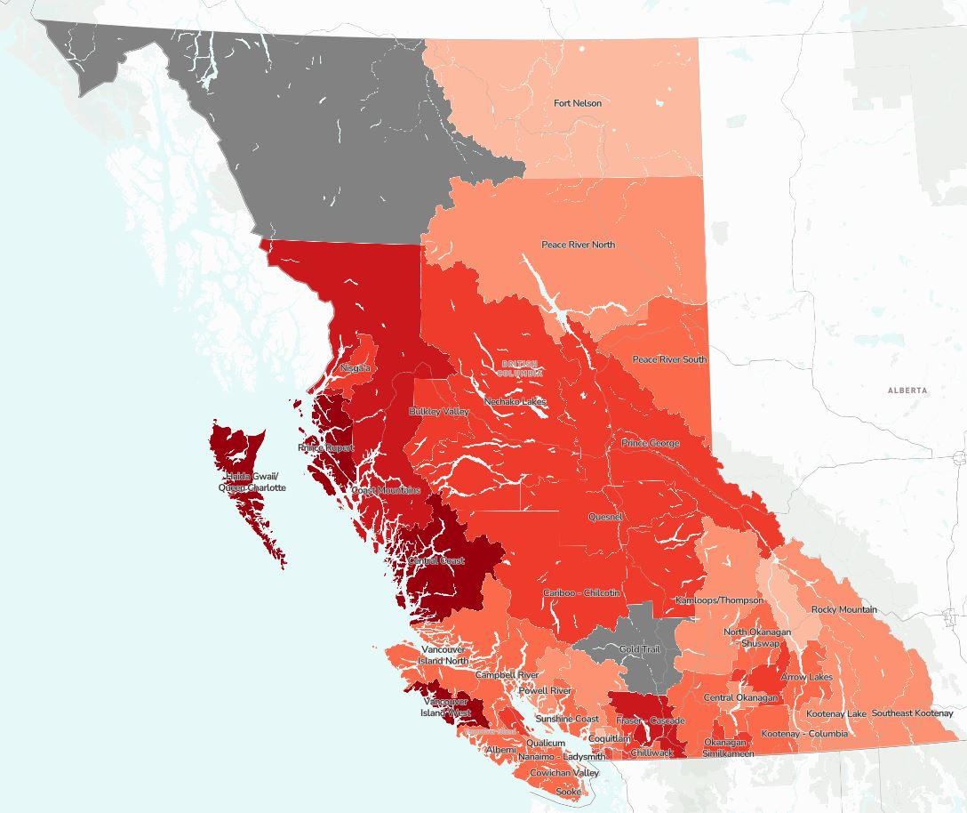
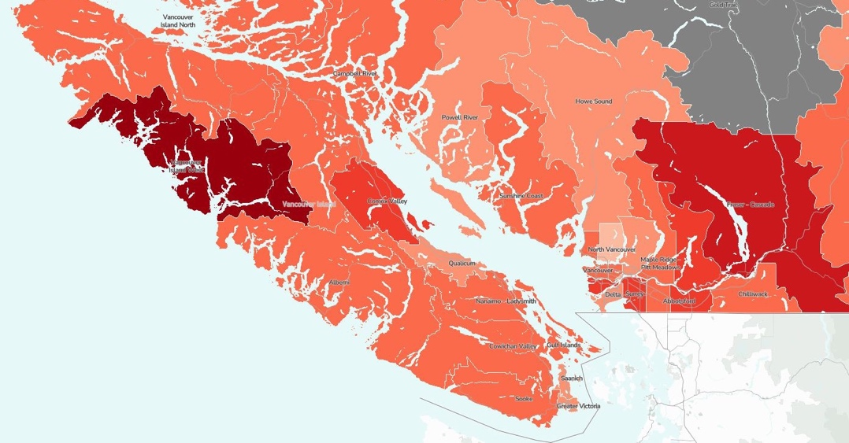
Overall Vulnerability, BC School Districts: Wave 8
32.9%
School District Range = 22% – 72.0%
Neighbourhood Range = 13% – 72.0%
Notes:
Here is the overall provincial picture of vulnerability on one or more scales across the province for Wave 8 by school district. This is a heat map so the darker the red, the higher the overall vulnerability rates and the lighter pink/white the lower the rates.
What is most evident from this map is that there continues to be significant disparity in vulnerability rates across the province.
At the School District level, the range in Overall Vulnerability rates goes from 22% at the lowest end to 72% at the highest.
And, this difference is even more pronounced at Neighbourhood level… for Wave 8 the range goes from a neighbourhood with 13% Overall Vulnerability to a high of 72%.
This demonstrates that children’s developmental outcomes are impacted by where they live in the province.

Slide 18
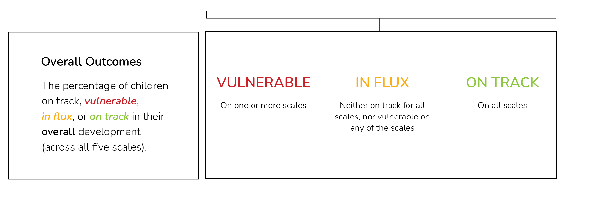
New Reporting Metrics: EDI Outcomes
Notes:
In past EDI data reporting, the focus has been on highlighting rates of developmental vulnerability in populations of children. However, the EDI measures the whole distribution of children's outcomes, allowing us to understand areas of strength and potential across the five key areas of development. And for the first time, HELP is incorporating the full range of outcomes in our reporting for Wave 8.
Here we see the icons representing the five scales of the EDI along the top and the explanations for the three Overall Outcome measures… so we just reviewed the trends for Overall Vulnerability which is the percentage of children who are vulnerable on one or more of the EDI scales.
Overall On Track is the percentage of children who are developmentally on-track across all five scales of the EDI. These children are most likely to have successful trajectories in school and beyond.
And, Overall In Flux is the percentage of children “in the middle” - neither vulnerable on one or more EDI scales NOR on track on all five scales. These children are considered to be “in flux” and may or may not catch up to their on-track peers and may benefit from additional supports.

Slide 19
BC Overall Outcomes, Over Time, Wave 2 – Wave 8
Notes:
Here we see the Overall Vulnerability rates we just shared from Wave 2 to Wave 8 and now we can add the Overall On Track and Overall In Flux rates over time.
What we see is that In Wave 8, while almost half of children (45.4%) were on track in all five areas of development, 32.9% were vulnerable in one or more areas of development and another 21.8% were in flux.

Slide 20
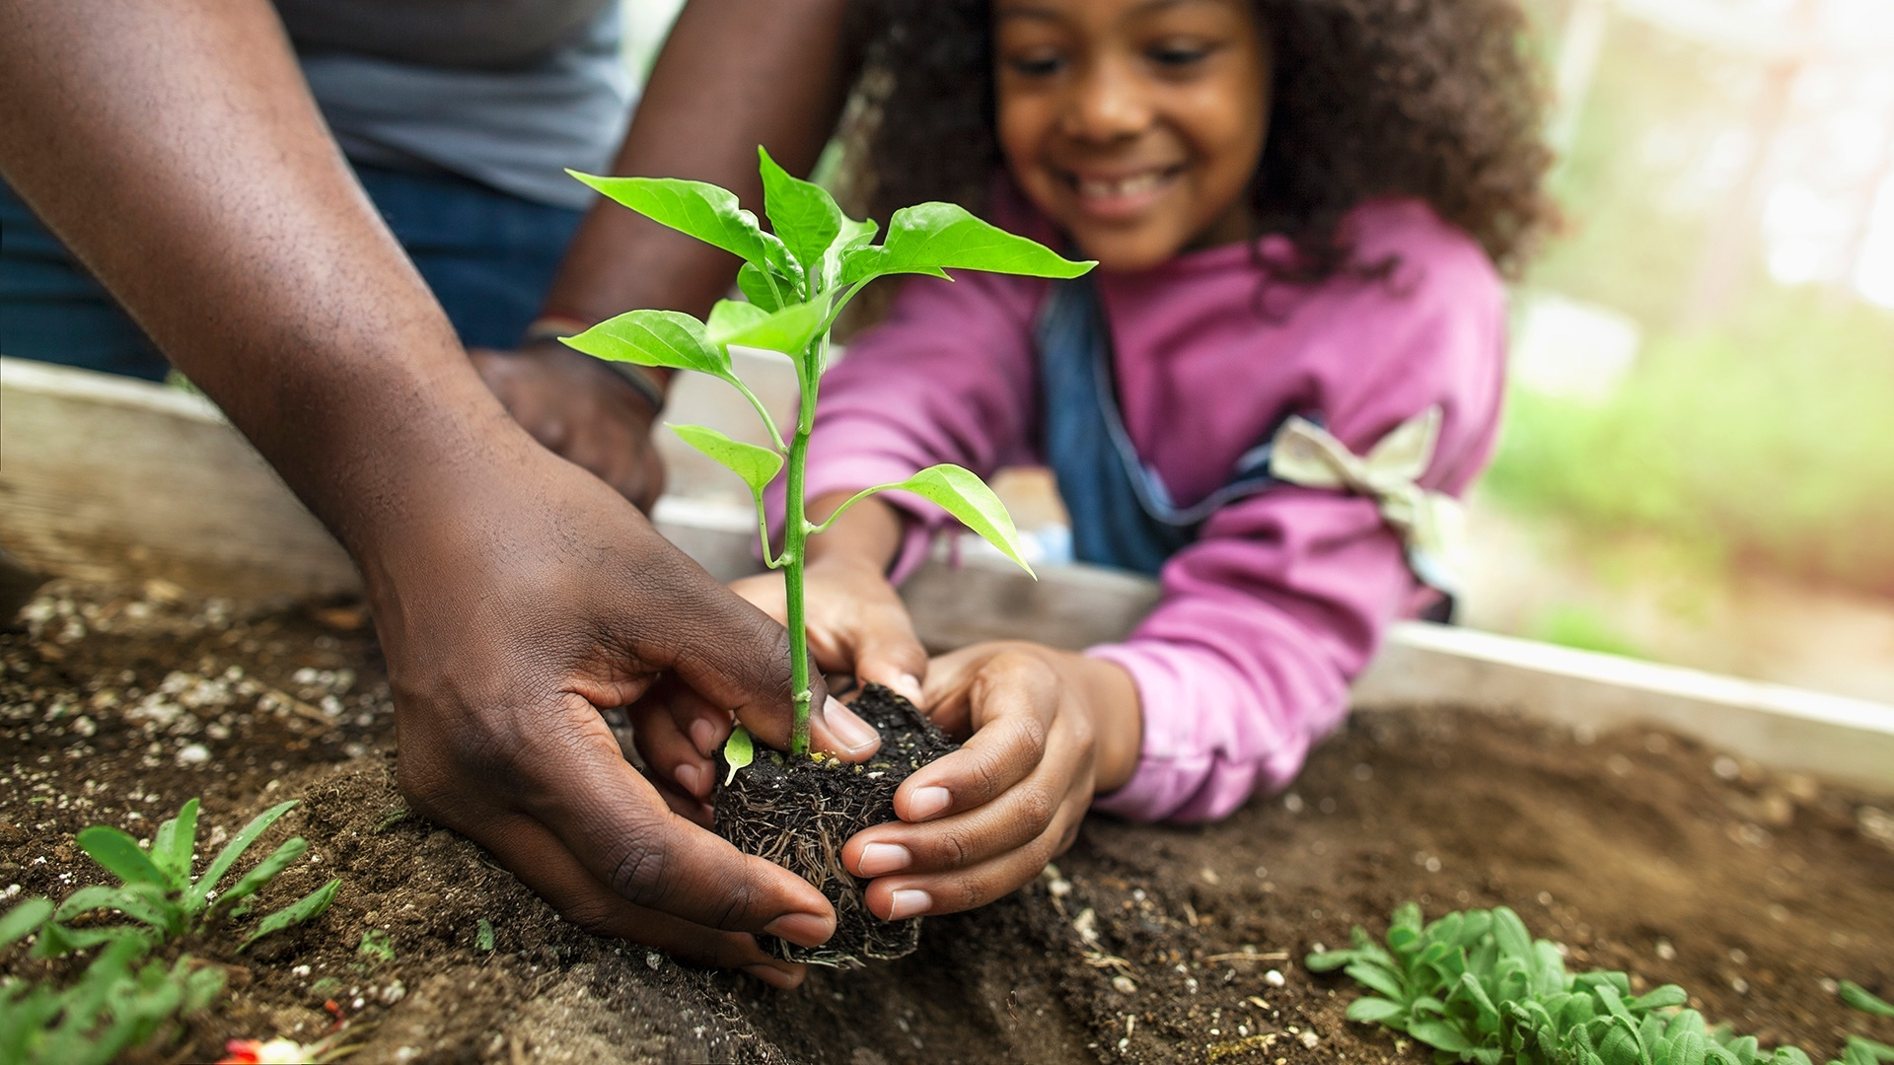
EDI Scales & Subscales
Notes:
EDI overall outcomes provide a summary of the developmental health of kindergarten children, but more specific information about each area of development can be found at the scale and subscale level which we will explore now…

Slide 21
New Reporting Metrics: EDI Outcomes
Notes:
And again, we are introducing the new reporting metrics and how they are determined at the Scale level… At the scale level, the full distribution of outcomes measure the percentage of children that are considered Vulnerable, At Risk and On Track on EACH SCALE of the EDI.
At the scale level, children whose scores are below the 10% cut-off score on a scale are considered VULNERABLE on that area of development.
Children whose scores are between the 10% and 25% cut-off scores are considered AT RISK in the area of development.
And, children who score above the 25% cut-off are considered ON TRACK in the specific area of development measured by the scale.

Slide 22
Wave 8: Scale-level Outcomes, Five Scales
Notes:
Here is what the distribution of outcomes at the scale level looks like across the 5 scales of the EDI for Wave 8.
You can see that most children are on track in their development on each scale of the EDI.
The highest on track rates are on the Language and Cognitive Development Scale at 78.4% of children, and the Communication Skills & General Knowledge scale with 75.3%. While the lowest on track rates is for Emotional Maturity with 67% of children on track in their development.
Now focusing on vulnerability rates, we see the flip with the Emotional Maturity scale having the highest vulnerability rate at 17.5% and Language & Cognitive Development with the lowest (10.5%).

Slide 23
Scale-level Vulnerability Trends, Wave 2 – Wave 8,
Five Scales
LT
ST
Percent Vulnerable
Wave 2 (2004-07) | Wave 3 (2007-09) | Wave 4 (2009-11) | Wave 5 (2011-13) | Wave 6 (2016-19) | Wave 7 (2013-16) | Wave 8 (2019-22)
Notes:
At this point, for trends over time, we are only reporting the VULNERABILTY rates at the scale-level as we can use the critical difference methodology to determine meaningful change across time.
Over the long-term, between Wave 2 and Wave 8, three of the five EDI scales – Physical Health & Well-being, Social Competence and Emotional Maturity – had meaningful increases in vulnerability.
The other two scales – Language & Cognitive Development and Communication Skills & General Knowledge – have had stable long-term trends. And Language and Cognitive Development has been the scale with the lowest vulnerability rates across all waves.
Over the short-term, between Wave 7 and Wave 8, all five scales had stable trends.
And this is what the trends in scale-level vulnerability look like in relation to one another.

Slide 24
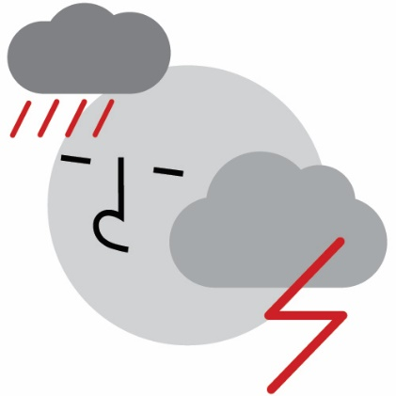
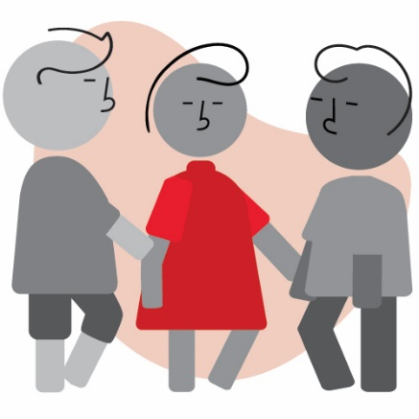
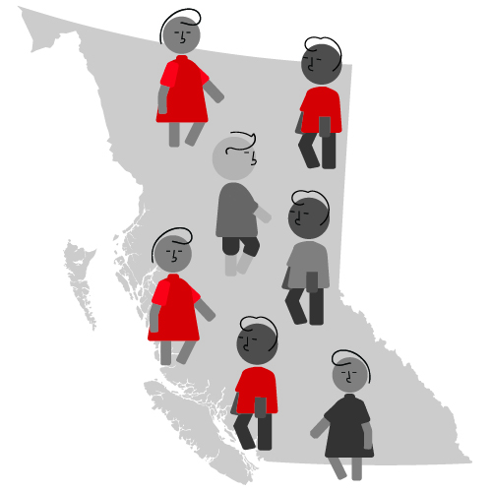
BC Wave 8: Summary of Key Findings
Still 1 in 3
Social Competence & Emotional Maturity continue as highest concern
Disparity in Overall Vulnerability rates across province remains
Notes:
To summarize that Key Wave 8 Findings…
There are still 1 in 3 kindergarten children in BC vulnerable on one or more core areas of development important for their future success.
Social Competence and Emotional Maturity continue to be the scales with the highest vulnerability rates, an that is concerning.
There continues to be disparity in overall vulnerability rates communities and neighbourhoods in BC

Slide 25
What are your reflections?

Slide 26
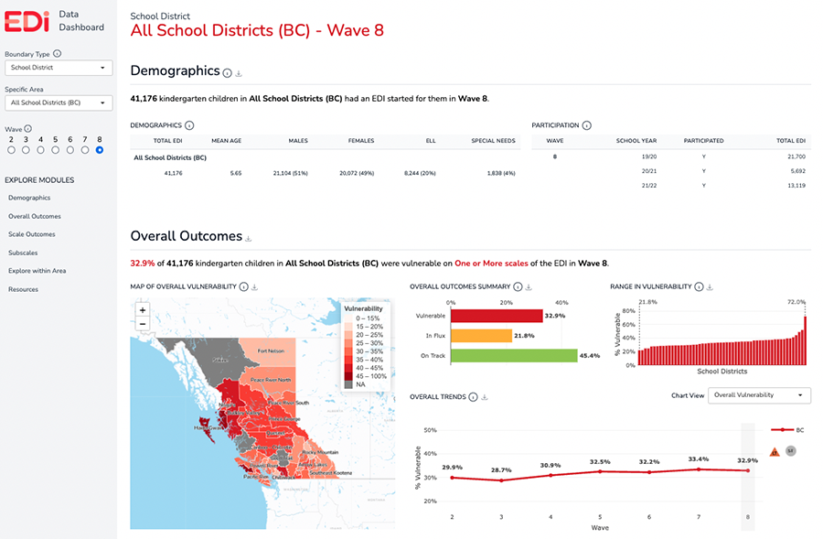
New EDI Data Dashboard
Notes:
Access dashboard: https://dashboard.help.ubc.ca

Slide 27
[Boundary Name] Wave 8 Data
Notes:
Add the name of your boundary type.

Slide 28
Demographics

Slide 29
SD48 Sea to Sky, Demographics & Participation
Example Slide
Notes:
The Demographics Module highlights demographic data for all boundary types. Participation data are only available when the School District boundary type is selected. All other boundary types (Health, MCFD and neighbourhood) do not have participation data.
Here we see the data for School District 48, Sea to Sky. The chart shows the “Total EDI” which is the total number of children in the school district for whom an EDI questionnaire has been started.
ELL - Designated English Language Learners based on school district administrative data.
Special Needs - Designated Special Needs based on school district administrative data.
The Participation Table shows which years in the EDI wave schedule that the school district participated in data collection. Here we see that Sea to Sky collected EDI data in two school years – 2019/20 and 2021/22. Note that data collection in the 2019/20 school year was collected prior to the WHO declaring the COVID-19 pandemic. This is considered “pre-pandemic”.

Slide 30
[Boundary name] Demographics & Participation
Download a full view of the Demographics Module for your selected boundary type and specific area of interest using the download icon that appears beside the module title:
Insert the downloaded .png of the module in this slide template.
Notes:
The Demographics Module highlights demographic data for all boundary types. Participation data are only available when the School District boundary type is selected. All other boundary types (Health, MCFD and neighbourhood) do not have participation data.
[Insert demographic (and if available, participation) highlights for the selected boundary type]
ELL - Designated English Language Learners based on school district administrative data.
Special Needs - Designated Special Needs based on school district administrative data.

Slide 31
Overall Outcomes

Slide 32
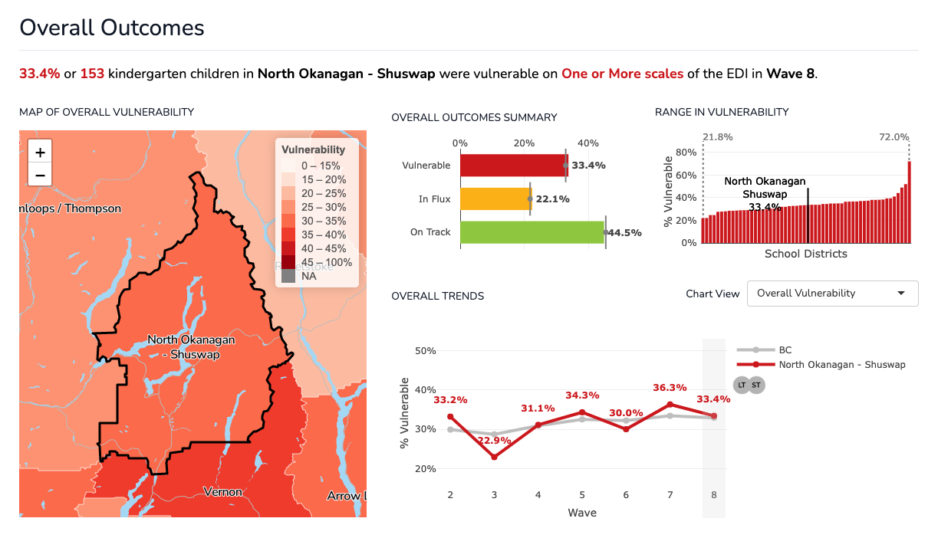
SD83 North Okanagan-Shuswap, Overall Outcomes
School District Example
Notes:
This module highlights the overall outcome data for the boundary type selected. Overall outcomes are the percentage of children vulnerable, in flux, or on track in their overall development across all five scales of the EDI. See the Technical Guide for more details.
The overall vulnerability maps are heat maps—the darker the colour the higher the vulnerability rate and the lighter the colour the lower the vulnerability rate. What you can learn from the maps? What stands out from the maps is the variability in vulnerability rates across communities.
The “Range in Vulnerability” chart, the black line shows the overall vulnerability rate for the boundary type selected (in this case North Okanagan-Shuswap) and where it sits in relation to all similar boundary types (in this case, all school districts in the province).

Slide 33
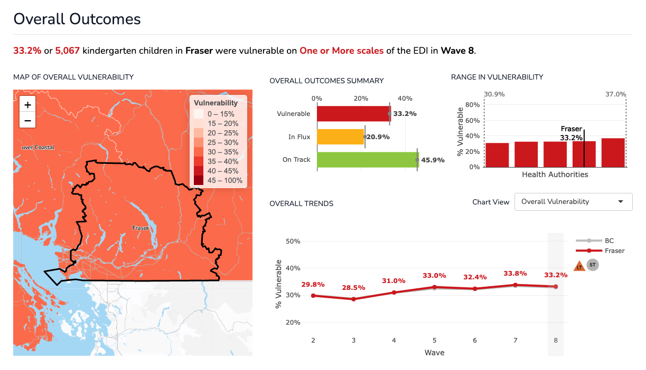
Fraser Health Authority, Overall Outcomes
Health Authority Example
Notes:
This is another example of the “Overall Outcomes” Module view, this time for another boundary type – Fraser Health Authority.
Note: The “Range in Vulnerability” chart, the black line shows the overall vulnerability rate for the boundary type selected (in this case Fraser Health Authority) and where it sits in relation to all similar boundary types (in this case, all other Health Authorities in the province).

Slide 34
[Boundary name], Overall Outcomes
Download a full view of the Overall Outcomes Module for your selected boundary type and specific area of interest using the download icon that appears beside the module title:
Insert the downloaded .png of the module in this slide.
Notes:
This module highlights the overall outcome data for the boundary type selected. Overall outcomes are the percentage of children vulnerable, in flux, or on track in their overall development across all five scales of the EDI. See the Technical Guide for more details: https://earlylearning.ubc.ca/edi-dashboard-technical-guide/
The overall vulnerability maps are heat maps—the darker the colour the higher the vulnerability rate and the lighter the colour the lower the vulnerability.
The “Range in Vulnerability” chart - the black line shows the overall vulnerability rate for the boundary type selected and where it sits in relation to all similar boundary types across the province.

Slide 35
Highlight 1: Overall Outcomes
Wave 8 EDI data for [boundary name] shows that [X]% of kindergarten children living in the area were on track in their overall development, [X]% were vulnerable on one or more EDI scales, and [X]% were in flux (neither vulnerable on any scale, nor on track on all).
Notes:
Use this slide to craft the “Highlight” for your boundary type.
Where [boundary name] appears above, replace with the name of the selected boundary type.
Where [X]% appears for each outcome (on track, vulnerable, in flux) above, replace with the percentages for the selected boundary type.

Slide 36
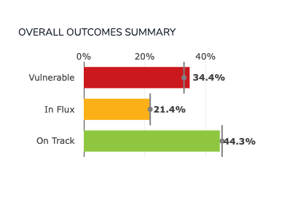
SD70 Pacific Rim, Wave 8, Overall Outcomes
Example Slide
Notes:
This chart comes from the Overall Outcomes Module.
Overall outcomes summary bar chart – This chart shows the percentage of children vulnerable (red), in flux (yellow), or on track (green) in their overall development for the boundary type selected. The vertical comparison line in these bar charts represents the average for all areas within the selected boundary type. For example, when viewing overall outcomes for a specific school district, the average line represents All School Districts (BC Average) within the selected wave.

Slide 37
[Boundary name], Wave 8, Overall Outcomes
Download an image of the Overall Outcomes Summary bar charts for your selected boundary type and specific area of interest using the download icon that appears beside the chart title:
Insert the downloaded .png of the chart in this slide.
Notes:
Here we see the “overall outcomes chart” for [boundary type].
Overall outcomes summary bar chart – This chart shows the percentage of children vulnerable (red), in flux (yellow), or on track (green) in their overall development for the boundary type selected. The vertical comparison line in these bar charts represents the average for all areas within the selected boundary type. For example, when viewing overall outcomes for a specific school district, the average line represents All School Districts (BC Average) within the selected wave.

Slide 38
Highlight 2: Trends Over Time
Over the long-term, [boundary name] has had a [stable/meaningful increase/meaningful decrease] trend in vulnerability rates, and over the short-term, a [stable/meaningful increase/meaningful decrease] trend.
Notes:
Use this slide to craft the “Highlight” for your boundary type.
Where [boundary name] appears above, replace with the name of the selected boundary type.
Where [stable/meaningful increase/meaningful decrease] appears, replace with the short- and long-term meaningful change trends as indicated beside the “Overall Vulnerability” trend line chart.

Slide 39
SD70 Pacific Rim, Overall Vulnerability Trends, Wave 2-8
Example Slide
Meaningful Change icons
Notes:
Here we see the trend line for “overall vulnerability” for School District 70 Pacific Rim, from Wave 2 (data collected 2004-07) to Wave 8 (2019-2022).
We can see that Pacific Rim has vulnerability rates slightly below the province until Wave 6, but for Waves 7 and 8 the rates have been above those for the province. We can also see that Pacific Rim has had a meaningful increase in vulnerability rates over the long-term (between Wave 2 and 8) but stable trends over the short-term (between Wave 7 and 8).

Slide 40
[Boundary name], Overall Vulnerability Trends, Wave 2-8
Download an image of the Overall Vulnerability trend chart for your selected boundary type and specific area of interest using the download icon that appears beside the chart title:
Insert the downloaded .png of the chart in this slide.
Select Chart View
Notes:
Here we see the trend line for “overall vulnerability” for [boundary type], from Wave 2 (data collected 2004-07) to Wave 8 (2019-2022). Note the meaningful change trends over time and how similar/different the red line (your boundary type) is from the grey line.

Slide 41
Highlight 3: Multiple Vulnerabilities
For BC overall, the proportion of children with 2 or more vulnerabilities has increased from Wave 2 to Wave 8.
For [boundary name] the proportion of children with 2 or more vulnerability has [been stable, increased, decreased].
Notes:
Use this slide to craft the “Highlight” for your boundary type.
Where [boundary name] appears above, replace with the name of the selected boundary type.
Where [been stable, increased, decreased] appears, if the percentage of children with 2 or more vulnerabilities has been stable, increased or decreased.
While many of the province’s vulnerable children experience challenges in a single area of development, some demonstrate multiple vulnerabilities, on two, three, four or all five scales of the EDI. Assessing the proportion of children experiencing multiple vulnerabilities, especially over time, provides us with an
in-depth perspective on the scope of vulnerability in the province.
Multiple Vulnerabilities Chart – shows the percentage of children who are vulnerable on one, two, three, four, or all five scales of the EDI for the selected area from Wave 2* to current wave. See sample chart below. Hover over the layers of bars to see the percentage of children vulnerable in each category – vulnerable on one, two, three, four or all five scales.

Slide 42
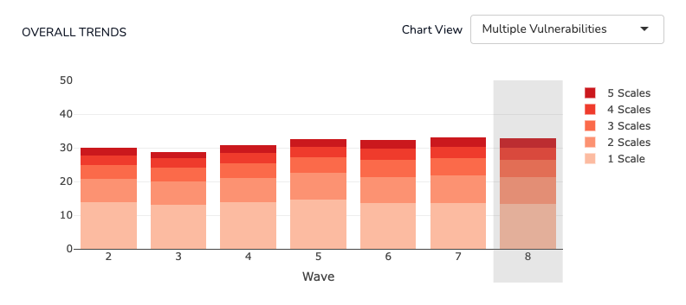
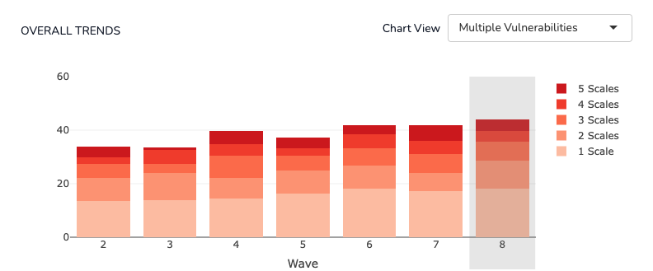
Example Slide
BC
16.0%
19.5%
SD 82 Coast Mountain
20.4%
26.0%
Notes:
This chart breaks down the vulnerability rates to show how many scales children are vulnerable on – what we call Multiple Vulnerabilities – over time from Wave 2 to Wave 8. If you were to draw a line connecting the top of each stacked bar chart, what you get is the trend line of the rates of children vulnerable on one or more EDI scales that we previously saw. Each stacked section of the bar chart breaks down the percentage of children who are vulnerable on just one EDI scale (the lightest colour), then the percentage who are vulnerable on 2, 3, 4, and 5 EDI scales.
Notable here is that the proportion of children with multiple vulnerabilities has increased over time – when we add up the percentage of children vulnerable on two or more scales, there has been an increase from 16% in Wave 2 to 19.5% in Wave 8 of children with multiple vulnerabilities.
This suggests that in addition to increased rates of overall vulnerability in BC over the long-term, the complexity of vulnerability also increased across the province.

Slide 43
BC
16.0%
19.5%
Download & insert the multiple vulnerability chart for your boundary type of interest and add up the percentage of children vulnerable on 2 or more scales to fill in the [X]%
[Boundary Name]
[X]%
[X}%
Notes:
This chart breaks down the vulnerability rates to show how many scales children are vulnerable on – what we call Multiple Vulnerabilities – over time from Wave 2 to Wave 8. If you were to draw a line connecting the top of each stacked bar chart, what you get is the trend line of the rates of children vulnerable on one or more EDI scales that we previously saw. Each stacked section of the bar chart breaks down the percentage of children who are vulnerable on just one EDI scale (the lightest colour), then the percentage who are vulnerable on 2, 3, 4, and 5 EDI scales.
Notable here for BC is that the proportion of children with multiple vulnerabilities has increased over time – when we add up the percentage of children vulnerable on two or more scales, there has been an increase from 16% in Wave 2 to 19.5% in Wave 8 of children with multiple vulnerabilities.
This suggests that in addition to increased rates of overall vulnerability in BC over the long-term, the complexity of vulnerability also increased across the province.
[Insert any notable highlights from the multiple vulnerability charts for the selected area. For example, have the proportion of children with multiple vulnerabilities increased or decreased over time?]

Slide 44
5 EDI Scales

Slide 45
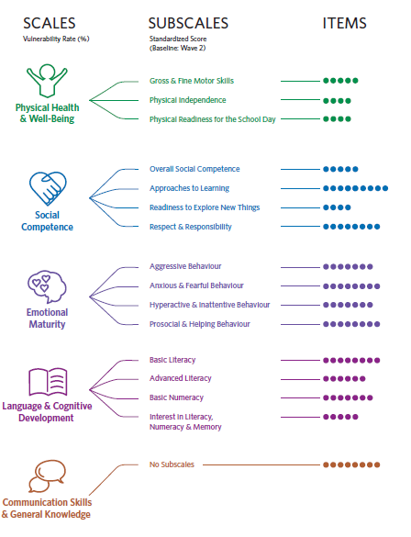
SCALES
Overall Outcomes
SUBSCALES
Standardized Scores
(Baseline Wave 2)
ITEMS
Scales & Subscales
Notes:
Each scale of the EDI except Communication Skills & General Knowledge, has a set of subscales.

Slide 46
Across the 5 scales of the EDI, [boundary name] had [similar, varied, higher, lower] rates of vulnerability than the province overall. Of the 5 scales, the [scale name] has the highest vulnerability rate of all the scales in Wave 8.
Highlight 4: Scale-Level Vulnerability Rates, Wave 8
Notes:
Use this slide to craft the “Highlight” for your boundary type.
Where [boundary name] appears above, replace with the name of the selected boundary type.
Where [similar, varied, higher, lower] appears, replace with information about the scale trends for the selected boundary type.

Slide 47
Wave 8, Vulnerability Rates, 5 EDI Scales,
[Boundary name] vs. Province Overall
[Boundary name] Wave 8, Overall Vulnerability = [X]%
Physical Health & Well-being | Social Competence | Emotional Maturity | Language & Cognitive Development | Communication Skills & General Knowledge
[X]% | [X]% | [X]% | [X]% | [X}%
BC Wave 8, Overall Vulnerability = 32.9%
Physical Health & Well-being | Social Competence | Emotional Maturity | Language & Cognitive Development | Communication Skills & General Knowledge
14.7% | 16.3% | 17.5% | 10.5% | 14.3%
Notes:
In the Scale Outcomes module, use the scale menu to toggle between each scale to find the percentage vulnerable.
Where [X]% appears, replace with the percent vulnerable for the corresponding scale for the selected boundary type. The BC percent vulnerable is already filled out.
To fill in the Overall Vulnerability percentage for the selected area, scroll up to the Overall Outcomes module to find the vulnerability rate.

Slide 48
Highlight 5: Wave 8, Range in Vulnerability
Compared to other similar boundary types, [boundary name] is [in the middle/at the lower/higher end] of the range in overall vulnerability.
Across the 5 scales of the EDI, the pattern is [similar/varied].
Notes:
Use this slide to craft the “Highlight” for your boundary type.
Where [boundary name] appears above, replace with the name of the selected boundary type.
Where [in the middle/at the lower/higher end] appears, replace with the best description for where the overall vulnerability rate for the selected boundary type sits in the range of vulnerabilities for similar boundaries.

Slide 49
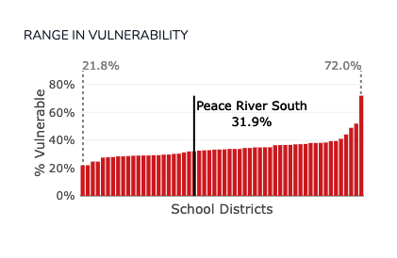
SD 59 Peace River South, Wave 8 Range in Overall Vulnerability
Example Slide
Overall Vulnerability
Notes:
Range in vulnerability chart – There is a wide range of overall vulnerability rates across all boundary types and areas. The range in vulnerability (overall) chart shows the distribution from lowest overall vulnerability to highest overall vulnerability within a selected boundary type. Each bar represents the overall vulnerability rate for similar boundary types (e.g., All school districts). The black bar, which appears when a specific area is selected, indicates the overall vulnerability rate for that selected area. This chart provides helpful context for how the boundary type selected compares to other similar boundaries in terms of overall vulnerability rates. For example, if viewing neighbourhood data, is the neighbourhood on the lower or higher end of the range, or in the middle? It can be helpful to view data across waves to note if the neighbourhood’s position has changed over time or if it has remained in a similar position relative to other neighbourhoods.

Slide 50
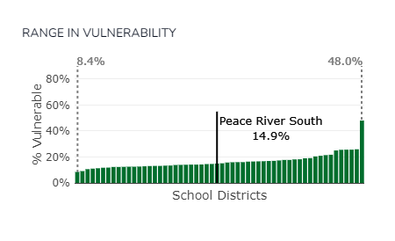
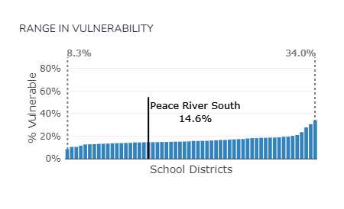
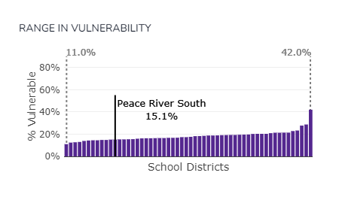
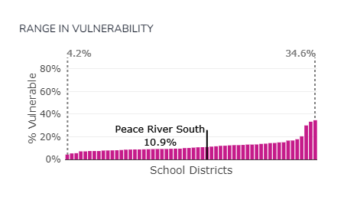
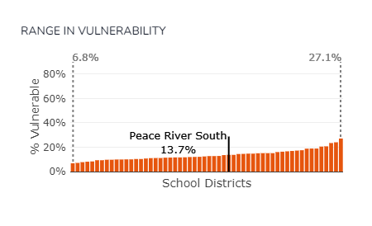
SD 59 Peace River South, Wave 8 Range in Vulnerability, 5 EDI Scales
Physical Health & Well-being
Social Competence
Emotional Maturity
Example Slide
Language & Cognitive Development
Communication Skills & General Knowledge
Notes:
Questions to consider:
How does your boundary type compare to others on each scale of the EDI?
Is there one scale that stands out as having vulnerability rates on the lower or higher side of the range?

Slide 51
[Boundary name], Wave 8 Range in Overall Vulnerability
Overall Vulnerability
Download an image of the Range in Vulnerability chart in the Overall Outcomes module for your selected boundary type and specific area of interest using the download icon that appears beside the chart title:
Insert the downloaded .png of the chart in this slide.
Notes:
Range in vulnerability chart – There is a wide range of overall vulnerability rates across all boundary types and areas. The range in vulnerability (overall) chart shows the distribution from lowest overall vulnerability to highest overall vulnerability within a selected boundary type. Each bar represents the overall vulnerability rate for similar boundary types (e.g., All school districts). The black bar, which appears when a specific area is selected, indicates the overall vulnerability rate for that selected area. This chart provides helpful context for how the boundary type selected compares to other similar boundaries in terms of overall vulnerability rates. For example, if viewing neighbourhood data, is the neighbourhood on the lower or higher end of the range, or in the middle? It can be helpful to view data across waves to note if the neighbourhood’s position has changed over time or if it has remained in a similar position relative to other neighbourhoods.

Slide 52
[Boundary Name], Wave 8 Range in Vulnerability, 5 EDI Scales
Physical Health & Well-being
Social Competence
Emotional Maturity
Language & Cognitive Development
Communication Skills & General Knowledge
Download & insert the Range in Vulnerability charts from the Scale Outcomes Module for your boundary of interest.
Notes:
To find this information, go to the Scale Outcomes Module and download the Range in Vulnerability charts for each scale.
How does your boundary type compare to others on each scale of the EDI?
Is there one scale that stands out as having vulnerability rates on the lower or higher side of the range?
These charts provides helpful context for how the boundary type selected compares to other similar boundaries in terms of overall vulnerability rates. For example, if viewing neighbourhood data, is the neighbourhood on the lower or higher end of the range, or in the middle? It can be helpful to view data across waves to note if the neighbourhood’s position has changed over time or if it has remained in a similar position relative to other neighbourhoods.

Slide 53
Highlight 6: Trends & Meaningful Change
Consider the relationship between the meaningful change trends in overall vulnerability and the scale-level trends.
Notes:
Use this slide to craft the “Highlight” for your boundary type.

Slide 54
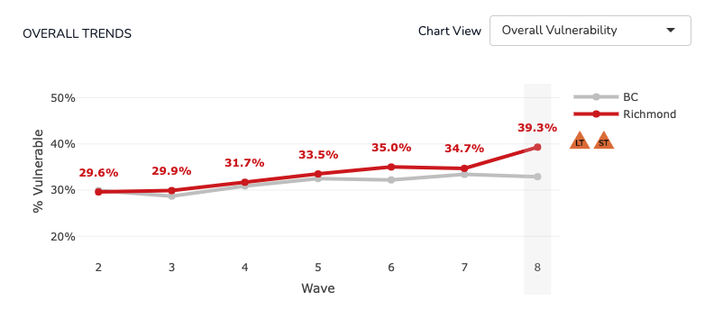
SD 38 Richmond, Overall Vulnerability Trends, Wave 2-8
Example Slide
Notes:
Here we see the Overall Vulnerability trend line from Wave 2 (data collected 2004-07) to Wave 8 (2019-2022) along with the meaningful change icons.
In this example for School District 38 Richmond, we can see that Richmond has had meaningful increases in vulnerability rates both over the long-term (comparing vulnerability rates from Wave 2 to Wave 8) and over the short-term (comparing rates from Wave 7 to Wave 8).

Slide 55
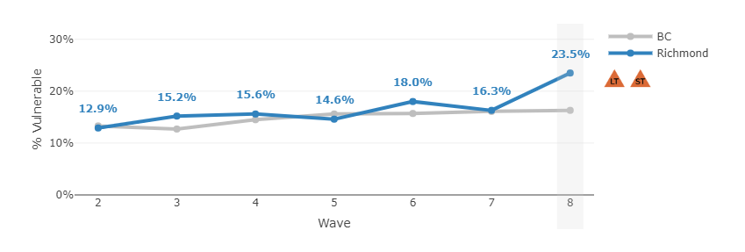
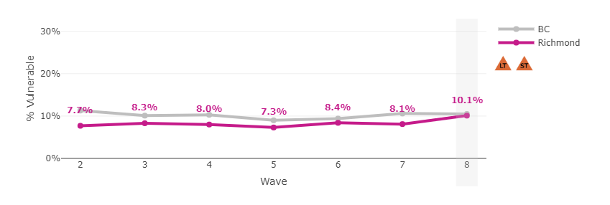
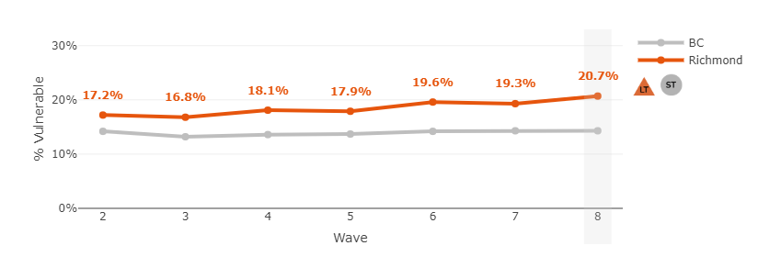
SD 38 Richmond, 5 Scales Vulnerability Trends, Wave 2-8
Example Slide
Physical Health & Well-being
Social Competence
Emotional Maturity
Language & Cognitive Development
Communication Skills & General Knowledge
Notes:
When we look at the “Scale Vulnerability” trend lines and the meaningful change trends, we can see which scales are contributing to the “overall vulnerability” trends.
In this example, we see that the Social Competence, Emotional Maturity and Language & Cognitive Development scales all had meaningful increases over both the long- and short-terms. The other two scales had meaningful changes over the long-term, but stable short-term trends.

Slide 56
[Boundary name], Overall Vulnerability Trends, Wave 2-8
Download an image of the Overall Vulnerability trend chart in the Overall Outcomes Module and Scale Vulnerability trend chart in the Scale Outcomes Module for your selected boundary type and specific area of interest using the download icon that appears beside the chart title:
Insert the downloaded .png of the overall vulnerability trend chart in this slide.
Notes:
Here we see the “Overall Vulnerability” trend line from Wave 2 (data collected 2004-07) to Wave 8 (2019-2022) along with the meaningful change icons.
Note how similar, different or varied has the red line (your boundary type) is from the grey line (in this case the province). Here we see that Richmond has been in fairly in line with the province overall until Wave 8.

Slide 57
[Boundary Name], Wave 8 Range in Vulnerability, 5 EDI Scales
Physical Health & Well-being
Social Competence
Emotional Maturity
Language & Cognitive Development
Communication Skills & General Knowledge
Insert the downloaded .png of the scale vulnerability trend charts in this slide.
Notes:
Questions to consider:
How does your boundary type compare to others on each scale of the EDI?
Is there one scale that stands out as having vulnerability rates on the lower or higher side of the range?
These charts provides helpful context for how the boundary type selected compares to other similar boundaries in terms of overall vulnerability rates. For example, if viewing neighbourhood data, is the neighbourhood on the lower or higher end of the range, or in the middle? It can be helpful to view data across waves to note if the neighbourhood’s position has changed over time or if it has remained in a similar position relative to other neighbourhoods.

Slide 58
Highlight 6: Closer look at [Scale Name]
For [Boundary name], the following EDI Scale(s) [scale name] are worth exploring in more detail.
Notes:
Use this slide to craft the “Highlight” for your boundary type.
Where [boundary name] appears above, replace with the name of the selected boundary type.
Where [scale name] appears, replace with the scale name(s) that are worth further exploration – perhaps it is the scale with the highest vulnerability rate in Wave 8 (highest area of concern), perhaps it is the scale that had the biggest change between Wave 7 & 8, or the scales with consistently lower vulnerability over time (strength).
What stands out for you?

Slide 59
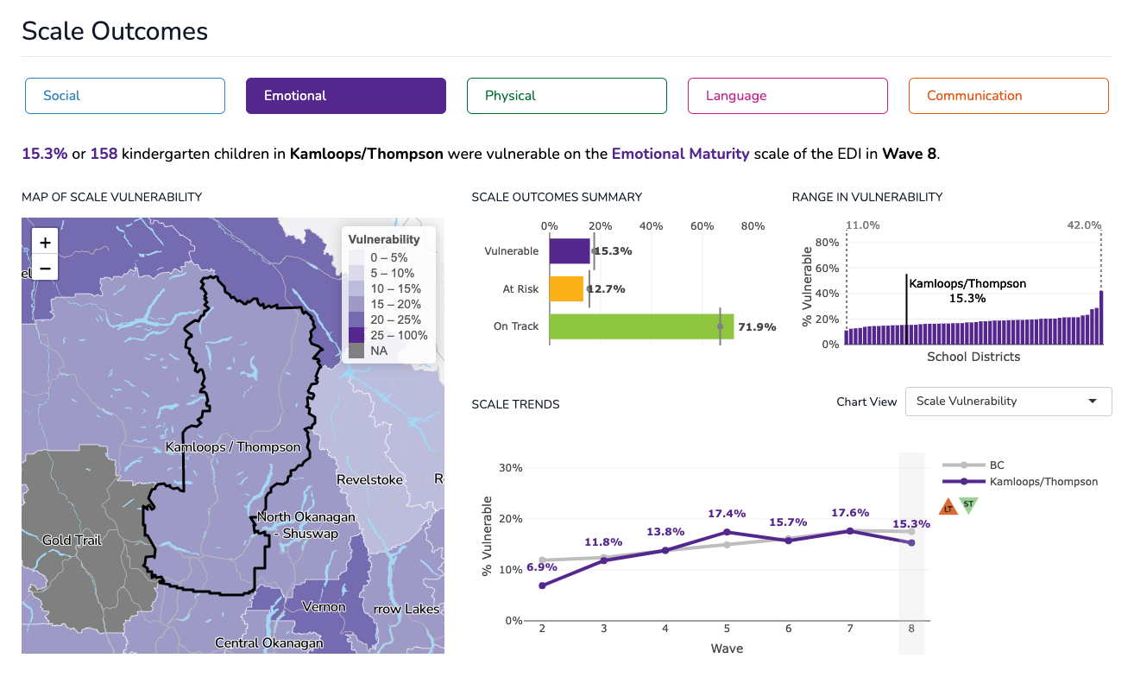
SD73 Kamloops/Thompson, Emotional Maturity Scale
Example Slide
Notes:
Here we see the Emotional Maturity scale trends for School District 73 Kamloops/Thompson. You can see that while the district saw meaningful long-term increases in the vulnerability rates for this scale, over the short-term, they have seen a meaningful decrease in the rate.
The Scale Outcomes Module highlights the scale-level outcome data for the scale and boundary selected. While EDI overall outcomes provide a summary of the developmental health of kindergarten children, more specific information about each of the five areas of development can be found at the scale and subscale level.
Vulnerable on an EDI scale – the percentage of children who score below the 10th percentile cut-off* in the area of development measured by the scale.
At Risk on an EDI scale – the percentage of children who score between the 10th and the 25th percentile cut-off* in the area of development measured by the scale.
On Track on an EDI scale – the percentage of children who score above the 25th percentile cut-off* in the area of development measured by the scale.
Note: *Cut-off scores: Scores from Wave 1 (2001–2004), the first wave of EDI collection, have been used to create cut-offs that divide children’s scores from all subsequent collections into three categories. Comparing to this first collection allows us to determine whether children’s developmental outcomes are getting better or worse.

Slide 60
[Boundary name], [Scale name]
Download an image of the Scale Outcomes Module for your selected boundary type and specific area of interest using the download icon that appears beside the module title:
Insert the downloaded .png of the chart in this slide.
Notes:
[Add specific highlights of the selected scale for the selected boundary type]
The Scale Outcomes Module highlights the scale-level outcome data for the scale and boundary selected. While EDI overall outcomes provide a summary of the developmental health of kindergarten children, more specific information about each of the five areas of development can be found at the scale and subscale level.
Vulnerable on an EDI scale – the percentage of children who score below the 10th percentile cut-off* in the area of development measured by the scale.
At Risk on an EDI scale – the percentage of children who score between the 10th and the 25th percentile cut-off* in the area of development measured by the scale.
On Track on an EDI scale – the percentage of children who score above the 25th percentile cut-off* in the area of development measured by the scale.
Note: *Cut-off scores: Scores from Wave 1 (2001–2004), the first wave of EDI collection, have been used to create cut-offs that divide children’s scores from all subsequent collections into three categories. Comparing to this first collection allows us to determine whether children’s developmental outcomes are getting better or worse.

Slide 61
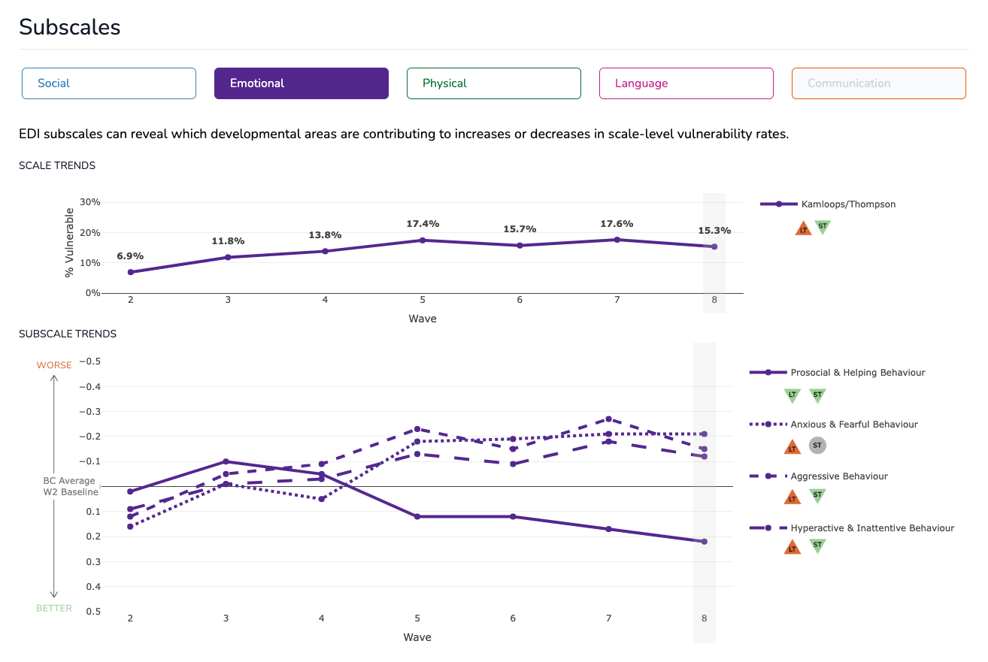
Example Slide
SD73 Kamloops/Thompson, Emotional Maturity Scale & Subscales
Notes:
The Subscales Module highlights the subscale outcome data for the scale and boundary type selected.
Each EDI scale is made up of a set of subscales (with the exception of the Communication Skills and General Knowledge Scale). There are 15 EDI subscales in total and each subscale measures a specific area of development contained within the larger scale. While data for the EDI scales allow us to assess trends and patterns in children’s vulnerability rates, subscale data allow us to refine our understanding of these population-level outcomes by providing information on the specific areas of development that are contributing to scale-level vulnerability.
Here we can see the Emotional Maturity subscale trends for School District Kamloops/Thompson. You can see that 2 of the 4 subscales (Aggressive Behaviour and Hyperactive & Inattentive Behaviour) have had meaningful increases over the long-term (Wave 2 to Wave 8) but meaningful decreases over the short-term (Wave 7 to Wave 8). One subscale, Anxious & Fearful Behaviour, has had a meaningful increase over the long-term but decrease over the short term. And the final subscale, has seen meaningful improvements over both the long- and short-terms, Prosocial & Helping Behaviour.
Scale Trends (% vulnerable) – The top line chart in this module is the scale-level trend line that shows the percentage of children vulnerable on the EDI scale selected. For each EDI scale, a child is designated as vulnerable if their score falls below the 10th percentile cut-off in the area of development measured by the scale.
Subscale Trends (standardized scores) – In contrast to the EDI scales, subscale data are reported as standardized versions of the raw scores. Subscale scores are benchmarked to the results of the Wave 2 provincial data collection (2004–2007), which is the earliest wave that HELP reports on. By using this benchmark as a baseline, the average provincial score for all subscales is set to zero for Wave 2. This allows us to both track trends over time in the subscale scores, and directly compare subscales with each other.
How to read the subscale trend graphs:
A downward trend line indicates that children are doing better than before, and that the subscale is contributing to a decrease in the vulnerability rate.
An upward trend line indicates that children are doing worse than before, and that the subscale is contributing to an increase in the vulnerability rate.
The symbols to the right of the chart indicate an area’s meaningful change in the long-term (LT) and short-term (ST). See more information on meaningful change.

Slide 62
Download an image of the Subscales Module for your selected boundary type and specific area of interest using the download icon that appears beside the module title:
Insert the downloaded .png of the chart in this slide.
[Boundary name], Scale & Subscales
Notes:
The Subscales Module highlights the subscale outcome data for the scale and boundary type selected.
Each EDI scale is made up of a set of subscales (with the exception of the Communication Skills and General Knowledge Scale). There are 15 EDI subscales in total and each subscale measures a specific area of development contained within the larger scale. While data for the EDI scales allow us to assess trends and patterns in children’s vulnerability rates, subscale data allow us to refine our understanding of these population-level outcomes by providing information on the specific areas of development that are contributing to scale-level vulnerability.
[Add specific highlights of the selected subscale for the selected boundary type]
Scale Trends (% vulnerable) – The top line chart in this module is the scale-level trend line that shows the percentage of children vulnerable on the EDI scale selected. For each EDI scale, a child is designated as vulnerable if their score falls below the 10th percentile cut-off in the area of development measured by the scale.
Subscale Trends (standardized scores) – In contrast to the EDI scales, subscale data are reported as standardized versions of the raw scores. Subscale scores are benchmarked to the results of the Wave 2 provincial data collection (2004–2007), which is the earliest wave that HELP reports on. By using this benchmark as a baseline, the average provincial score for all subscales is set to zero for Wave 2. This allows us to both track trends over time in the subscale scores, and directly compare subscales with each other.
How to read the subscale trend graphs:
A downward trend line indicates that children are doing better than before, and that the subscale is contributing to a decrease in the vulnerability rate.
An upward trend line indicates that children are doing worse than before, and that the subscale is contributing to an increase in the vulnerability rate.
The symbols to the right of the chart indicate an area’s meaningful change in the long-term (LT) and short-term (ST). See more information on meaningful change.

Slide 63
Exploring Within: Sub-Region (Neighbourhood) Data & Maps

Slide 64
Considerations for Sub-Region (Neighbourhood) Data
Differences in neighbourhood vulnerability rates in Wave 8 (% children vulnerable):
Neighbourhoods with noticeable strengths
Neighbourhoods with noticeable concerns
Neighbourhood patterns – consistently above/below/or varied when compared to the school district rates over time
Critical decreases or increases in vulnerability over the short- and long-term
Distribution of children across neighbourhoods (and # of children vulnerable)
Notes:
Questions to consider:
What stands out for you?
What other questions do these data raise?
What early years issue are you most concerned about at the moment?

Slide 65
MCFD, Northern Region, Wave 8, Sub-Region Overall Vulnerability Rates
Example Slide
Hover over the bars in this chart to reveal more data.

Slide 66
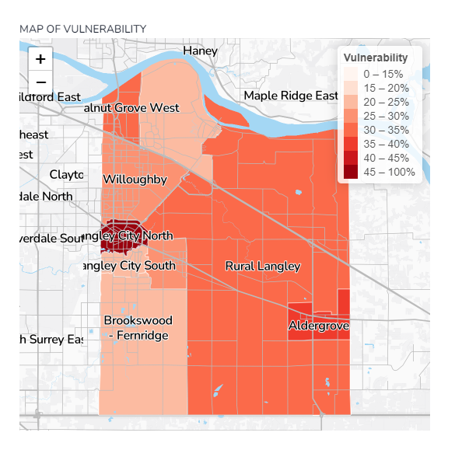
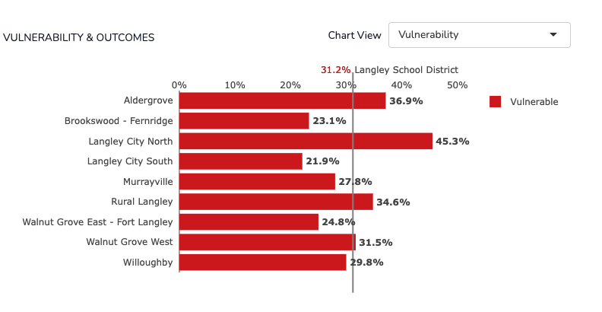
SD35 Langley Neighbourhoods, Wave 8, Overall Vulnerability Rates
Example Slide
Notes:
The neighbourhood vulnerability maps are heat maps where the darker the colour the higher the vulnerability rate and the lighter the colour the lower the vulnerability rate.
What you can learn from the maps?
What stands out from the maps is the variability in vulnerability rates across neighbourhoods within a community. There will likely be some neighbourhood vulnerability rates that don’t surprise you and some that do. Reflect on that. Sometimes we have assumptions about our communities that do not play out when looking closely at the data.
While noting which neighbourhoods have the highest vulnerability rates is important, it is also key to consider the number of children living in each neighbourhood.

Slide 67
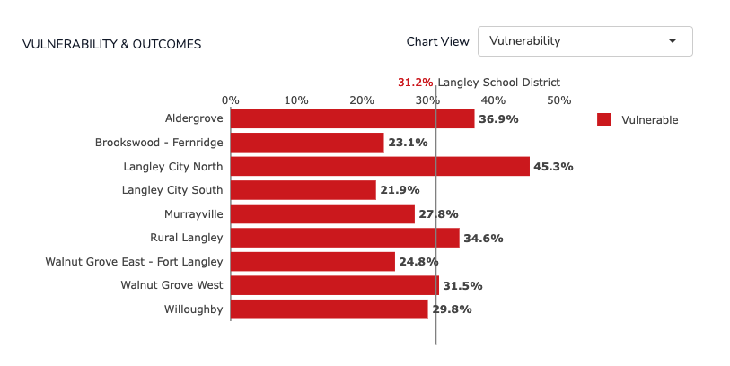
SD35 Langley Neighbourhoods, Wave 8, Overall Vulnerability Rates
Number of Children Vulnerable
Aldergrove | 55
Brookswood-Fernridge | 25
Langley City North | 68
Langley City South | 23
Murrayville | 22
Rural Langely | 65
Walnut Grove East | 38
Walnut Grove West | 28
Willoughby | 138
Example Slide
Notes:
If we add the number of children vulnerable (on one or more scales of the EDI) for each neighbourhood we can see that the neighbourhood with the highest vulnerability rate doesn’t always have the biggest number of children vulnerable—it depends on the number of children in the neighbourhood that had an EDI completed for them by their kindergarten teacher.

Slide 68
Note changing demographic neighbourhood profiles over time.
Notes:
Here we see the “total EDIs” collected in a neighbourhood of School District 35 Langley. The total EDI number is a proxy for the number of kindergarten children that live in the neighbourhood (note: while some independent (private, Francophone) and First Nations schools do participate in EDI data collection, the numbers are typically small so most often the number of kindergarten children noted in EDI data are just those attending public schools).
In this example, we can see that the number of kindergarten children increased considerably over time for this neighbourhood.

Slide 69
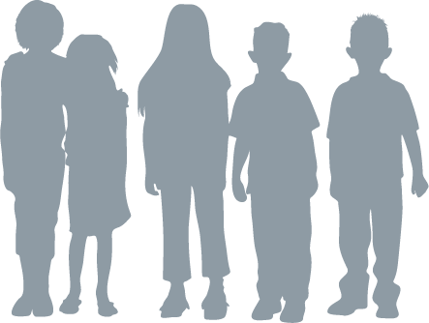
Meaningful Change
The amount of uncertainty increases as the number of children in a place decreases, so you need a larger difference to be meaningful
Smaller
number of children
larger amount
of difference needed to be meaningful
larger
number of children
smaller amount
of difference needed to be meaningful

Slide 70
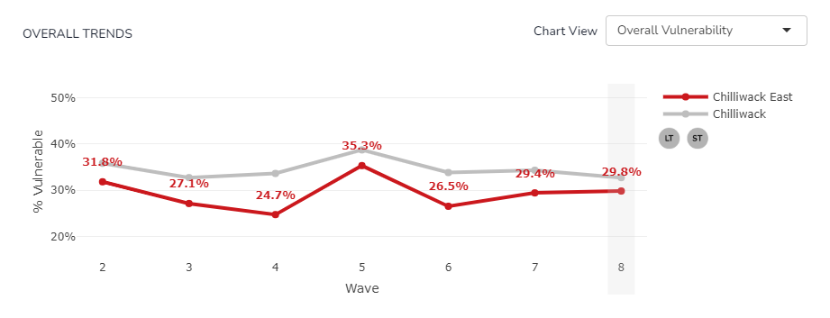
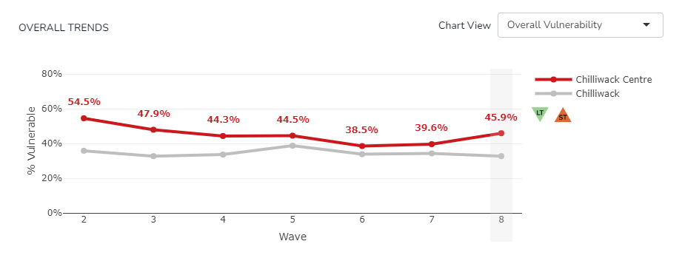
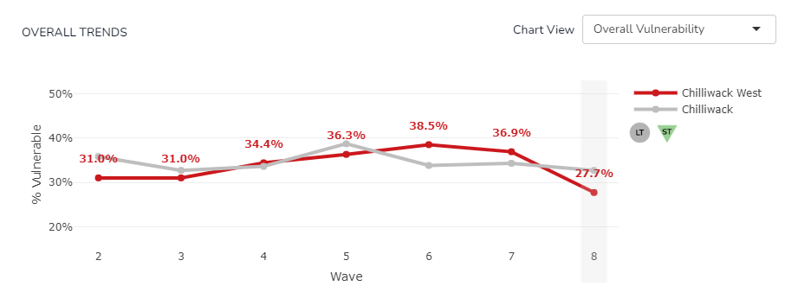
A neighbourhood with vulnerability rates consistently below school district rates.
Note different trends over time for sub-regions.
Example Slide
A neighbourhood with vulnerability rates consistently above school district rates.
A neighbourhoodwith changing patterns over time.
Notes:
Noting differences between neighbourhods in the overall vulnerability trend lines can also provide some insight into which neighbourhoods have experienced consistently higher/lower or more varied rates than the school district or ‘parent’ boundary to the sub-regions.

Slide 71
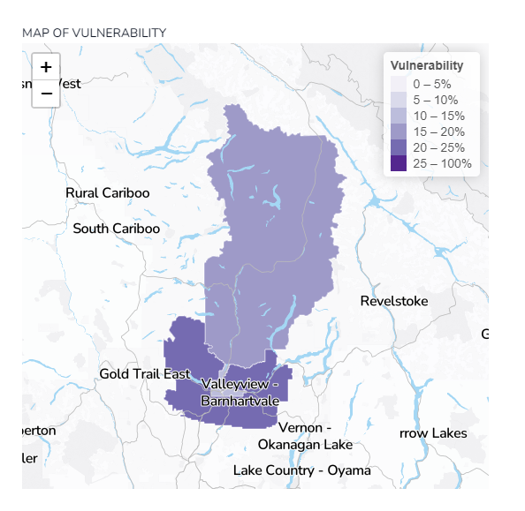
SD73 Kamloops/Thompson, Wave 8 Neighbourhood Vulnerability Rates,
Emotional Maturity Scale
Example Slide, Explore within Area Module, Scale Level
Notes:
You can also look at neighbourhood (a sub-region of school districts) scale-level patterns.
What you can learn from the maps?
What stands out from the maps is the variability in vulnerability rates across NHs within a community at the scale level.

Slide 72
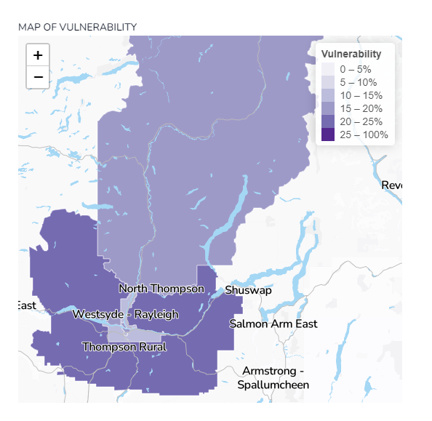
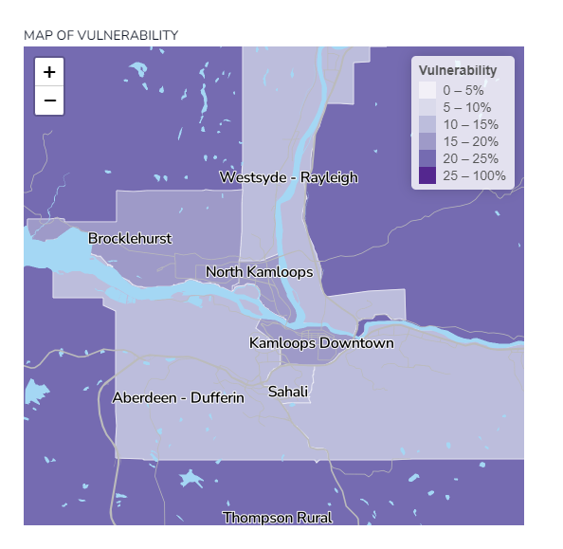
Example Slide, Map Zoom Feature
Notes:
Here we are showing that for some communities, the map zoom feature (using the + and – signs on the map in the Dashboard) will help zoom in for a clearer picture of the neighbourhood trends.

Slide 73
Highlight 7: Sub-Region (Neighbourhood) Trends
Exploring variability in vulnerability rates within the sub-regions/neighbourhoods of
[Boundary name].
Notes:
Use this slide to craft the “Highlight” for your boundary type.
Where [boundary name] appears above, replace with the name of the selected boundary type and note any stand out patterns in neighbourhood (or sub-region) data.

Slide 74
[Boundary name], Sub-region Vulnerability Rates,
[Scale name]
Download images of the Overall and/or Scale Vulnerability maps in the Explore within Area Module for the selected boundary type and specific area of interest using the download icon that appears beside the chart title:
Insert the downloaded .pngs of the chart in this slide.
Notes:
Use the top menu in the Explore within Area module to view sub-region data for Overall and each of the five scales.

Slide 75
Complementary Data Sources

Slide 76
Complementary Data Sources
Other Child Development Monitoring System Data
Adolescent Health Survey, BC Speaks COVID-19
First Call Poverty Report Cards
Census data
Municipal data summaries, population projection reports
Administrative health, local health authority
Education data
Community reports/surveys – ex. child care audits
Research by local organizations or provincial bodies
Local knowledge & expertise, including voice of families

Slide 77
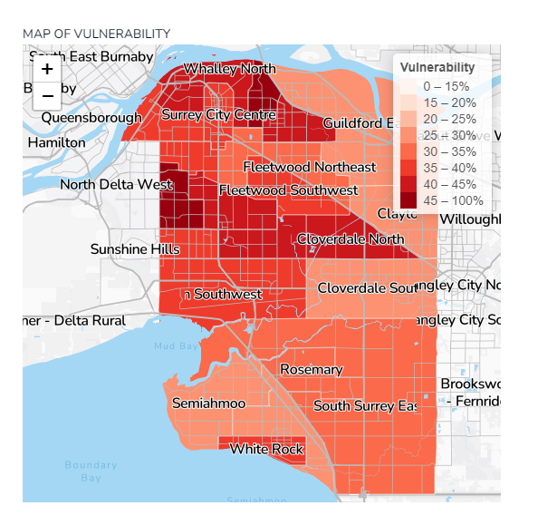
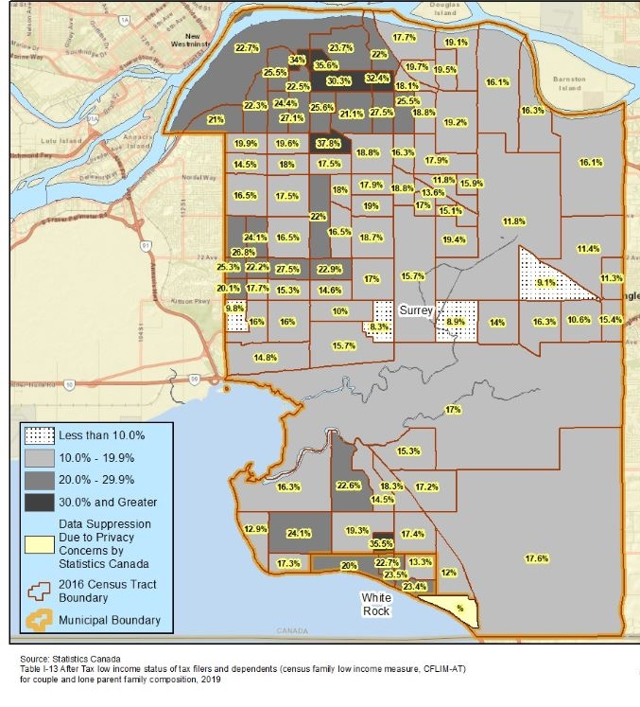
Surrey EDI Wave 8 (2019-2022)
Neighbourhood Overall Vulnerability
Percent of Children in Low Income Families, Surrey 2019 (First Call Poverty Census Track Map)
Notes:
As an example of useful complementary data sources, here we have included the First Call Poverty Census Track Map for Surrey (found at the website link below) and compared it to the overall vulnerability rate map for Surrey from Wave 8. The Poverty Census Track Maps are heat maps, the darker the colour the higher the rate of low income families in a particular area. Here we can see the relationship between neighbourhoods with higher poverty rates to those with higher overall vulnerability rates.
Research with the EDI over the last two decades has consistently shown the relationship between EDI and family and neighbourhood socioeconomic status. For more information, see this research article, a Narrative Review of Studies using the EDI: https://www.mdpi.com/1660-4601/18/7/3397
This is suggesting that the barriers and challenges faced by families living with low incomes and in low income NHs – whether those are struggles to meet basic needs, access safe and stable housing, and finding appropriate child care, and more – these stressor can impact children’s early experiences and in turn their development over time.
First Call Poverty Census Track Maps 2021: https://still1in5.ca/2021-bc-wide-census-tract-maps/
First Call Poverty Report Card 2022: https://firstcallbc.org/bc-child-poverty-report-card/

Slide 78
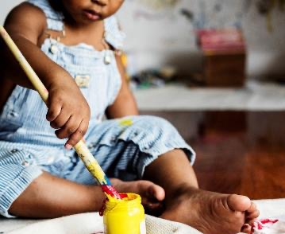
Early Childhood Experiences
Notes:
While the EDI has provided us with important child development information, there has been little systematic data collected on early experiences and contexts of children prior to the start of school at a population level. CHEQ (Childhood Experiences Questionnaire) is aiming trying to fill that gap and collect data which may provide some insight into why we see the variability of vulnerability rates that we see with the EDI data.

Slide 79
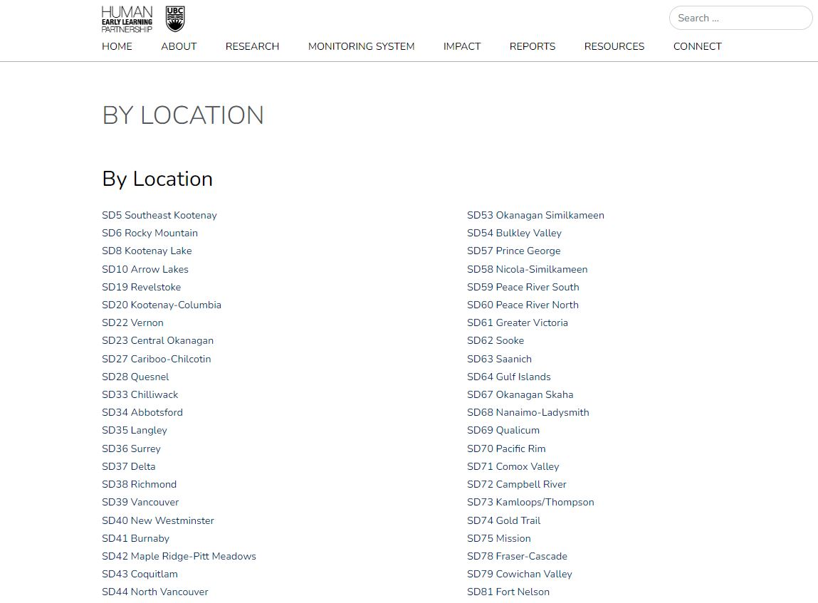
Notes:
On the HELP website, you are able to search “By Location” to see the most recent Child Development Monitoring System data available for your community. As of March 2023, you will be able to see if your community participated in data collection across CHEQ and MDI. As the YDI is implemented by Dr. Hasina Samji at SFU, you can go to the YDI Chart Lab reports page (link below) to see reports from that project.
HELP Website Reports Page: https://earlylearning.ubc.ca/reports/by-location/
YDI Reports Page: https://chartlab.ca/about-ydi/reports/#school-reports

Slide 80
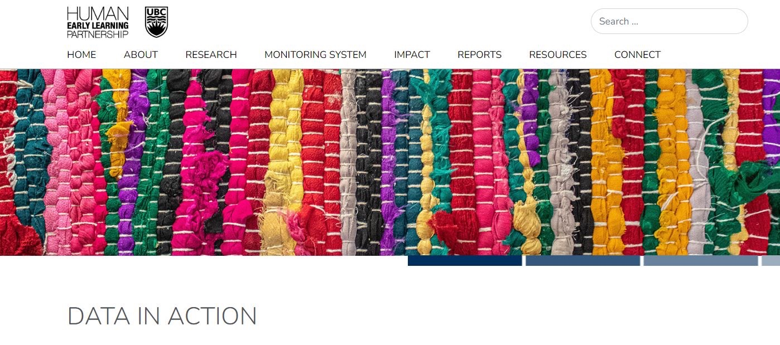
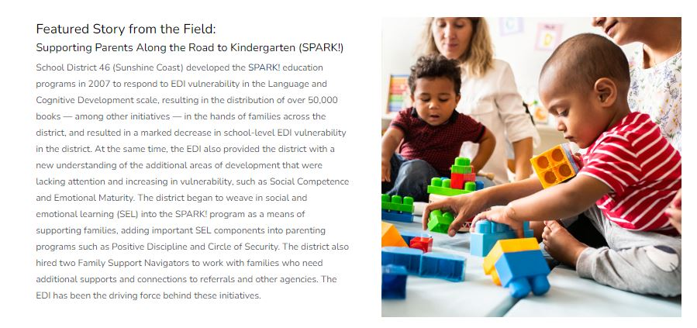
Impact: 20 Years Of EDI Data
For over 20 years HELP has promoted ‘equity from the start’, and used evidence to support and improve the health and well-being of children growing up in BC, Canada and beyond.
Notes:
EDI data are actively used by multiple systems, organizations and policy makers across the province. And, on our new website, you can find information on how EDI and other Child Development Monitoring System data have been used to good effect over the years.
https://earlylearning.ubc.ca/impact/data-in-action/

Slide 81
Discussion…
Do these data reflect what you see around you in [Boundary name]?
What patterns/trends emerged for you as most important to pay attention to?
What additional insights do they provide into children and families in [Boundary name]?
What are some next steps to consider after reviewing these data?

Slide 82
Thank you!
HELP website: https://earlylearning.ubc.ca/
Email: communications@help.ubc.ca
@HELP_UBC
Facebook.com/HumanEarlyLearningPartnership

